Slide 1


Single Page Applications
Mónica Rodrigues
26/05/2017

Slide 2




Who am I?
Mónica Rodrigues
Degree in Computer Science Engineer at ISEL
Software Engineer since 2010
Keywords: Web Applications, ASP.NET MVC, ASP.NET Web Api, REST, Javascript, Angular, Best practices, Design patterns, Clean Code, SQL Server
Single Page Applications
Mónica Rodrigues
26/05/2017

Slide 3
Contents
What is SPA?
Motivations / Considerations
Multiple Page Applications vs Single Page Applications
Frameworks Javascript / SPA Samples
What I need to begin?
Best practices / Recommendations
Single Page Applications
Mónica Rodrigues
26/05/2017

Slide 4
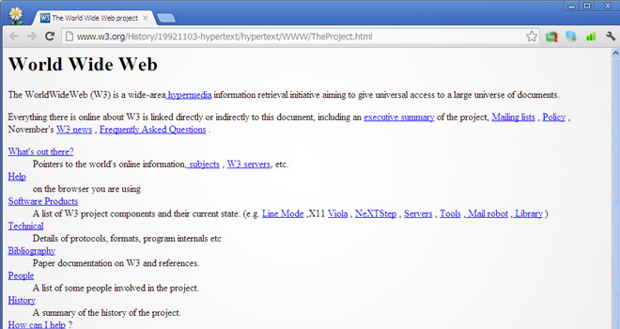
First page – Long time ago
Single Page Applications
Mónica Rodrigues
26/05/2017

Slide 5
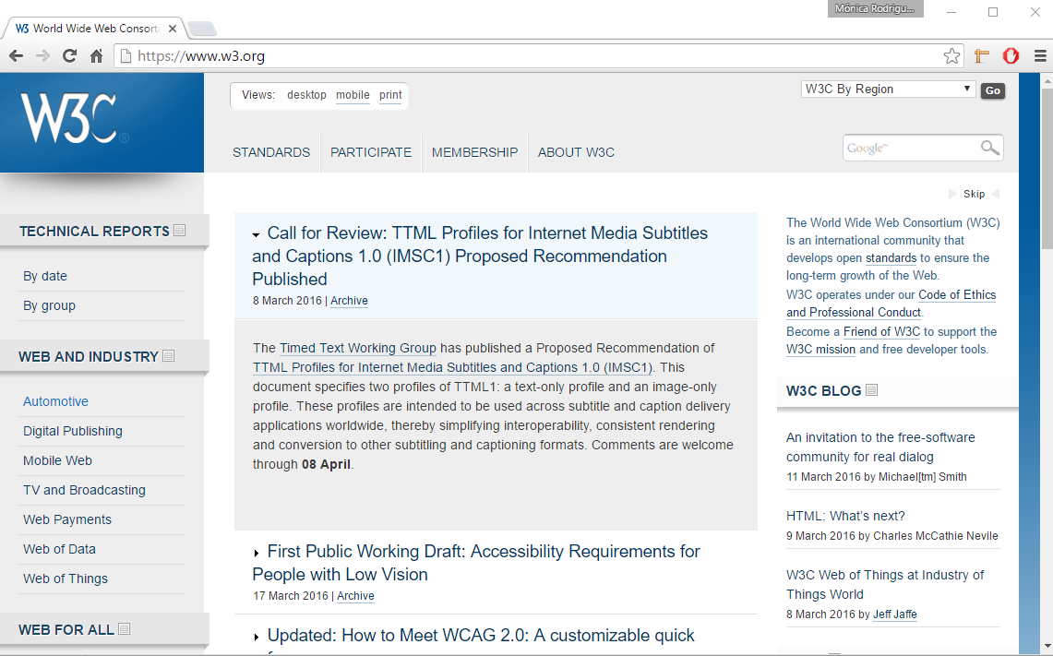
Today
Single Page Applications
Mónica Rodrigues
26/05/2017

Slide 6

Challenge
Users want a central place to view or take actions on most or all content so they don’t have to waste time navigating between pages.
Single Page Applications
Mónica Rodrigues
26/05/2017

Slide 7


Solution
Go to a SPA
Single Page Applications
Mónica Rodrigues
26/05/2017

Slide 8
Solution
Use modern web development techniques to build a single-page app that doesn’t need to reload itself as the user browses through it.
SPA
Single Page Application
Single Page Applications
Mónica Rodrigues
26/05/2017

Slide 9
Motivations
Reach
Web app may be accessible on different platforms and devices
Round trip
Web app not require many round trips between client and server
Better user experience
Separation of responsibilities between client and server
Single Page Applications
Mónica Rodrigues
26/05/2017

Slide 10
Considerations
The first time that the application loads is slow
Maintain Navigation, Deep linking and History
SEO (Search engine optimization) is complicated
Single Page Applications
Mónica Rodrigues
26/05/2017

Slide 11
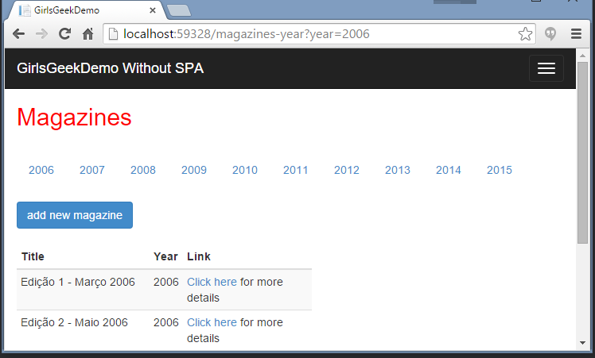

Multiple page application
Page access
Page rendering
Returns rendered page
Single Page Applications
Mónica Rodrigues
26/05/2017

Slide 12
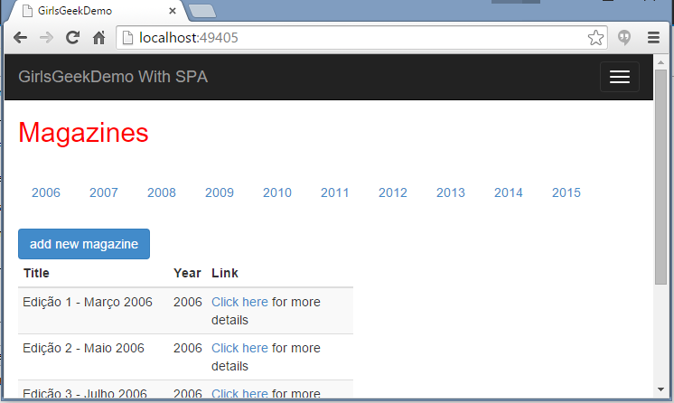

Single page application
DOM processing and manipulation
Requests data
Returns data
Single Page Applications
Mónica Rodrigues
26/05/2017

Slide 13
SPA and Multiple Page Application (Mix)
Products Page
Mini
SPA
Request Data
Response Data
Request Data
Categories Page
Response Data
Mini
SPA
Single Page Applications
Mónica Rodrigues
26/05/2017

Slide 14






Some Javascript Frameworks and Libraries
Single Page Applications
Mónica Rodrigues
26/05/2017

Slide 15







SPA Samples
Single Page Applications
Mónica Rodrigues
26/05/2017

Slide 16

What I need to begin?
Choose a framework or library
Depends, what do you want to do?
Choose a IDE and structure your folders
Think about your application, namely HTML structure and CSS
Lets start with Javascript ☺
Don’t forget the best practices !!!!
Single Page Applications
Mónica Rodrigues
26/05/2017

Slide 17
Recomendations
Best practices in Javascript
Join and minify CSS files and Javascript files
Use a task runner like Gulp
App.js
site.min.js
App-users-controller.js
Learn MVVM pattern
Single Page Applications
Mónica Rodrigues
26/05/2017

Slide 18
Javascript Patterns
Functions as abstractions
Functions to build modules
Functions to avoid global variables
Single Page Applications
Mónica Rodrigues
26/05/2017

Slide 19
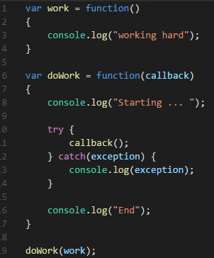
Functions as abstractions
Single Page Applications
Mónica Rodrigues
26/05/2017

Slide 20
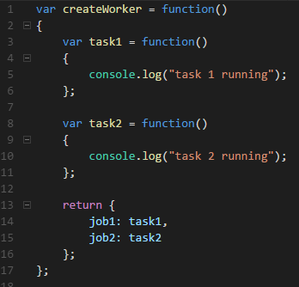

Functions to build modules
Revealing module pattern
Single Page Applications
Mónica Rodrigues
26/05/2017

Slide 21

Functions to build modules
What’s the matter with previous code?
There are two global variables
worker
createWorker
There variables can be redefined in other files
Single Page Applications
Mónica Rodrigues
26/05/2017

Slide 22
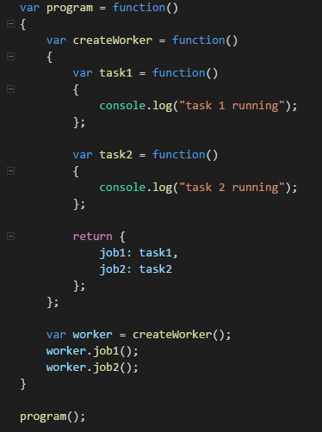
Functions to avoid global variables
Reduce to 1 global variable
But, how can I get 0 global variables?
Single Page Applications
Mónica Rodrigues
26/05/2017

Slide 23
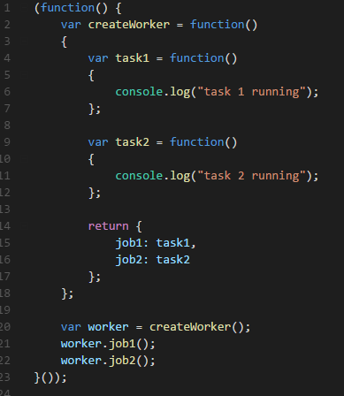
Functions to avoid global variables
Single Page Applications
Mónica Rodrigues
26/05/2017

Slide 24




Thank You!
Mónica Rodrigues
Email: monica85rodrigues@gmail.com
Blog: http://mrodiguesblog.azurewebsites.net/
@Monita85Rodrig
https://pt.linkedin.com/in/monicascrodrigues
https://github.com/monica85rodrigues
Single Page Applications
Mónica Rodrigues
26/05/2017

